Slide 1
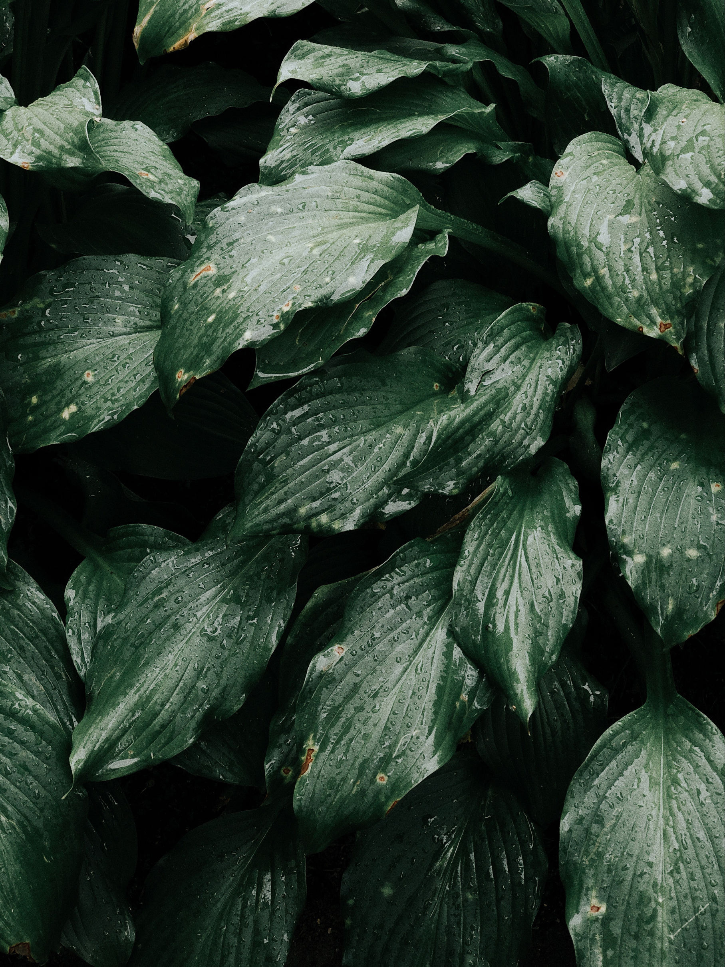

Leafotev: Plant Disease Detection Using Their Leaves
Presented by:
Muhammad Zafeer 022
Zaheer Ud Din Akram 026
Presented To:
Mam Gulshen

Slide 2

Introduction
Our project focused on potato plant disease detection via their leaves.
Targeting potato diseases like Early Blight and Late Blight.
Utilizing technologies: TensorFlow, Keras, Tkinter

Slide 3



Technologies Used
TensorFlow & Keras: For building and training the deep learning model
Tkinter: Creating the user interface for image upload and predictions

Slide 4
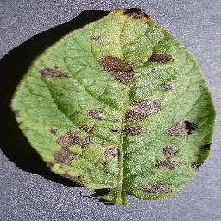
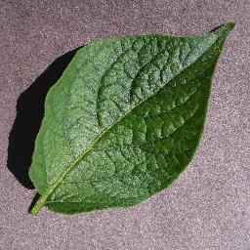
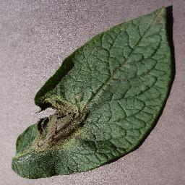
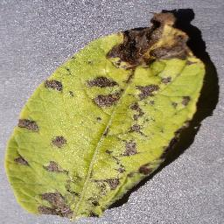
Methodology
Data Preprocessing
Model Building
Model
Dataset
TensorFlow dataset
Data Augmentation
Export Model
Convolutional neural network (CNN)

Slide 5
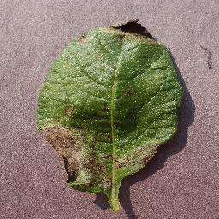
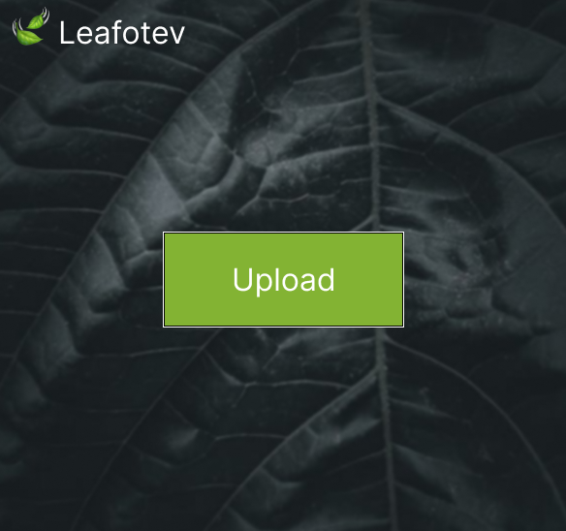
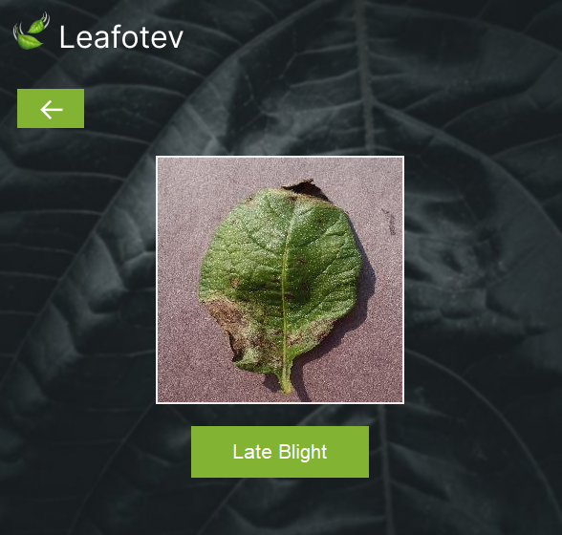
Methodology
Upload Image
Model
Load Model
Desktop App
Show Result

Slide 6
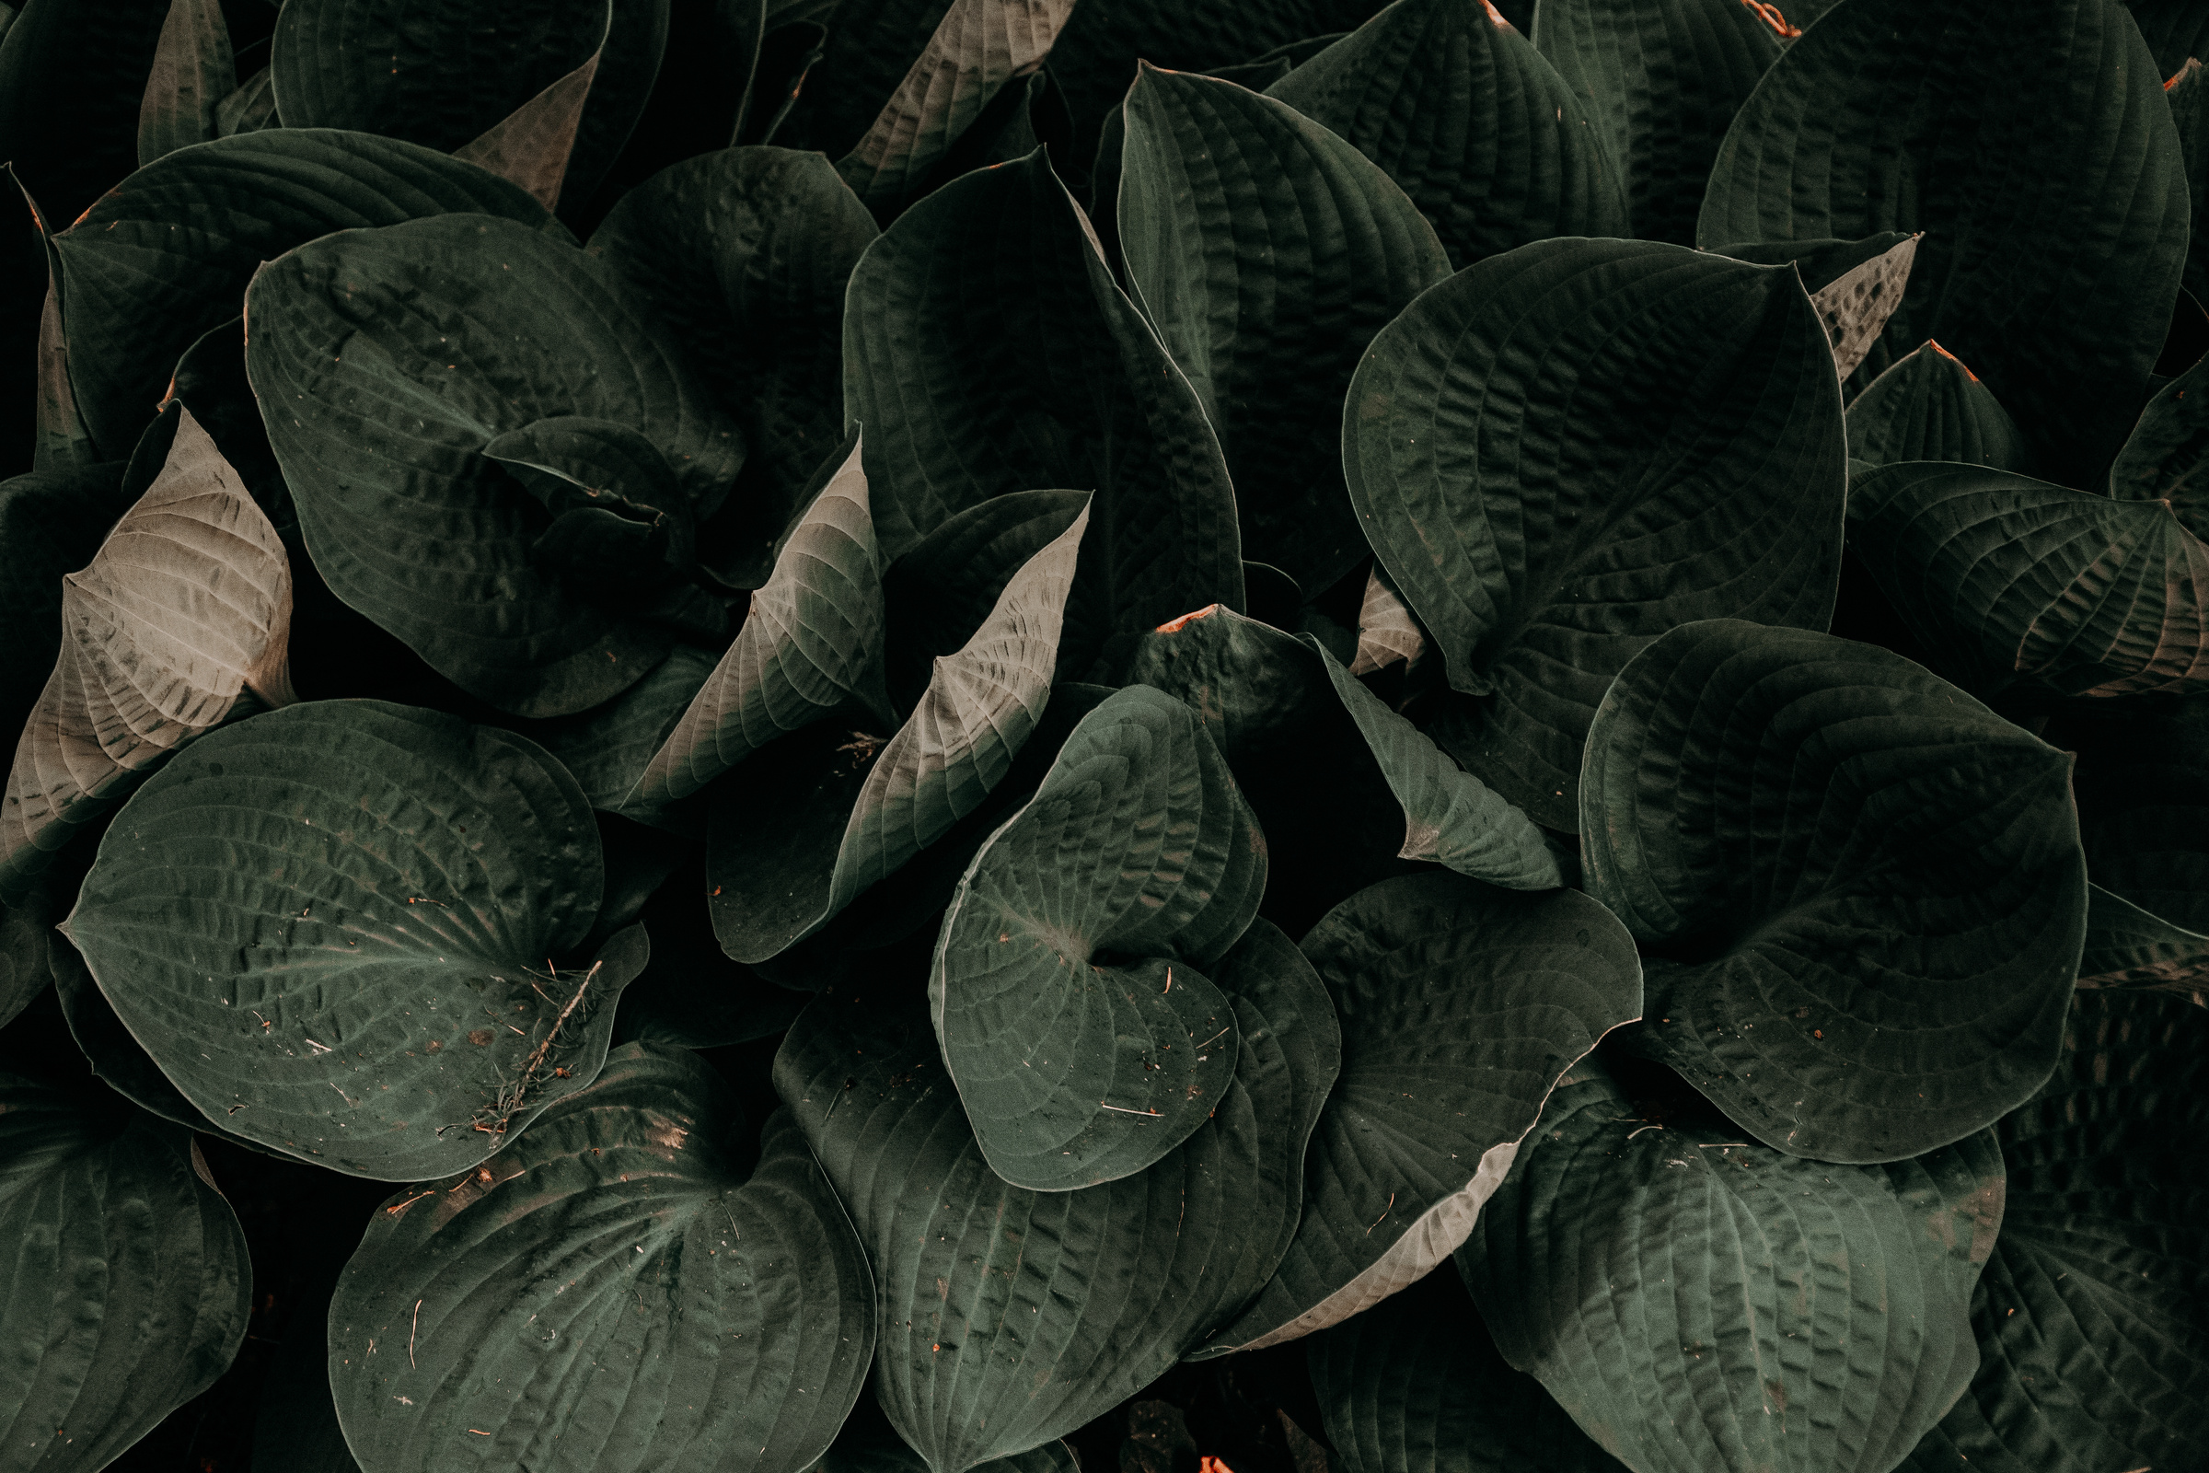
Model Training
Convolutional Neural Network (CNN)
Epochs: 50
Validation Accuracy: 99.36%
Test Accuracy: 96.09%

Slide 7

Dataset
Source: Kaggle
Dataset Link: https://www.kaggle.com/datasets/abdallahalidev/plantvillage-dataset
Selection: Only potato leaves extracted for focused analysis

Slide 8
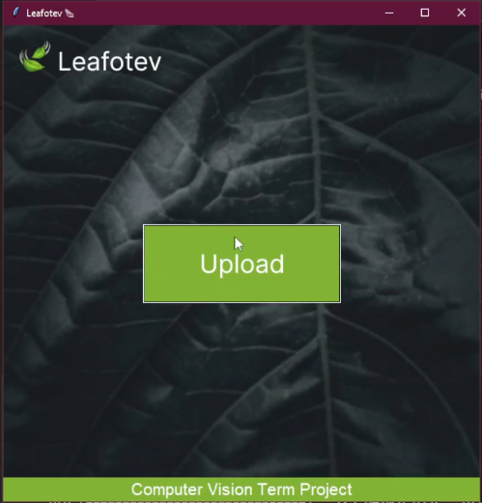
User Interface

Slide 9
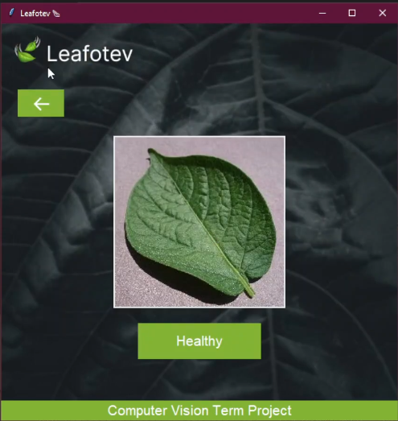
Predicted as a Healthy

Slide 10
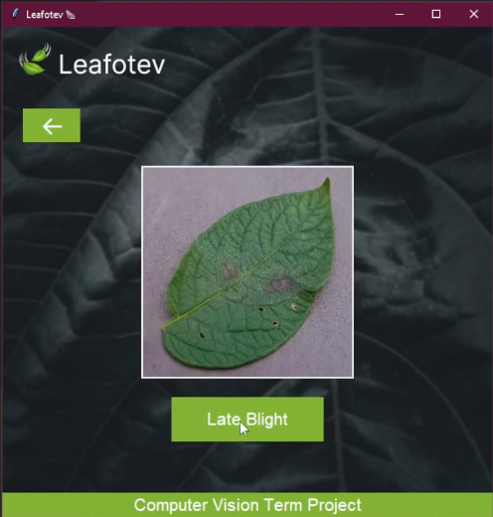
Predicted as a Late Blight

Slide 11
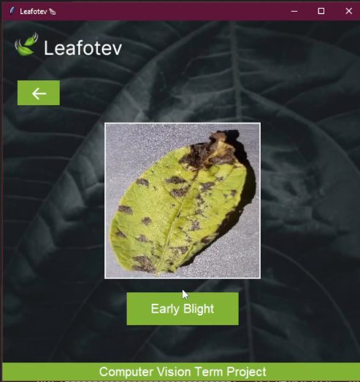
Predicted as a Early Blight

Slide 12
Conclusion
Successful development of a plant disease detection system
High accuracy rates achieved with CNN and TensorFlow

